Slide 1
Introduction to MESSAGE-V
Görkem Güngör
E-mail: ggungor@enerji.gov.tr

Slide 2
Model Structure
INPUT
Energy System Structure
MESSAGE
Model for Energy Supply System Alternatives and their General Environmental Impacts
OUTPUT
Primary and final energy mix
Emissions and waste streams
Environmental impacts
Resource use
Land use
Import dependence
Investment requirements
Base year energy flows and prices
Energy demand projections
Technology and Resource Options
Technical and policy constraints

Slide 3
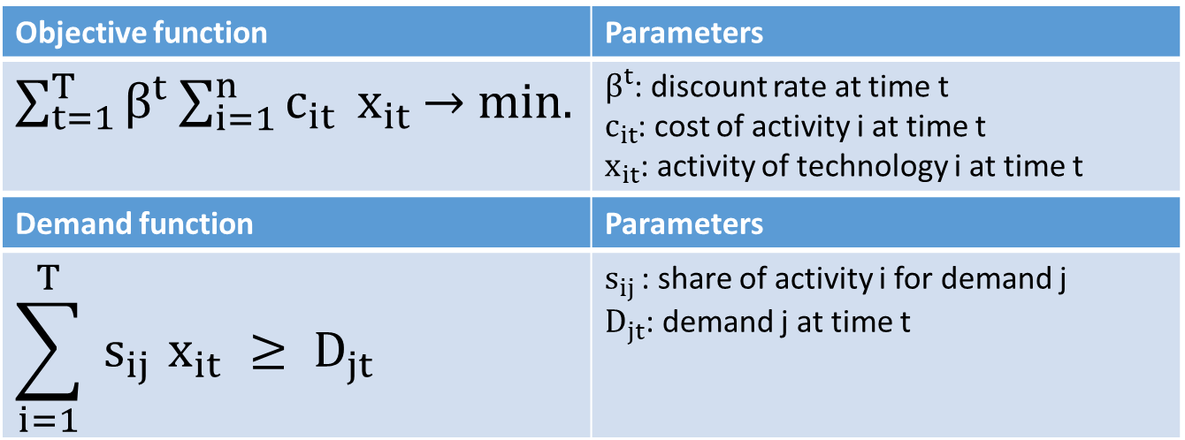
Some Mathematics

Slide 4
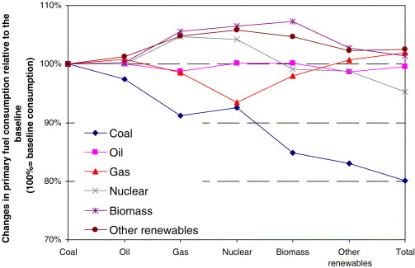
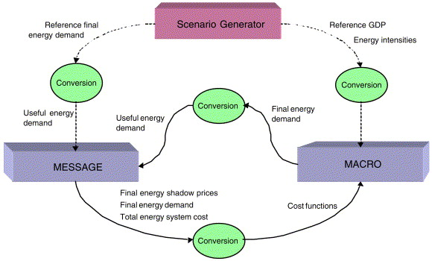
Socioeconomic Variables
Energy and climate policies have an impact on the GDP which should be mitigated
Iterative usage of energy and economic models calculates the demand quantities with respect to their costs/values
Energy model is constrained by capital (infrastructure) and environmental impacts
Economic model is constrained by capital (prices) and labor (wages)
Notes:
Klaassen, G., & Riahi, K. (2007). Internalizing externalities of electricity generation: An analysis with MESSAGE-MACRO. Energy Policy, 35(2), 815–827. https://doi.org/https://doi.org/10.1016/j.enpol.2006.03.007

Slide 5
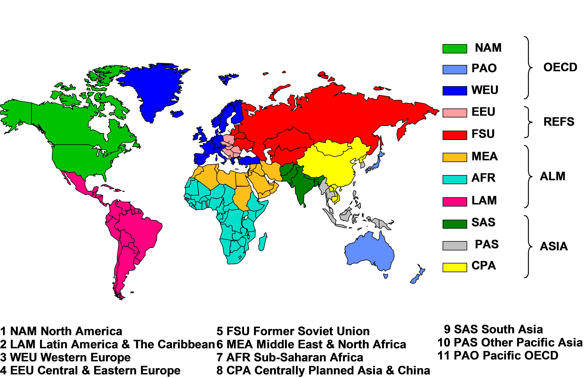
Spatial Coverage
Regional aggregation of countries with similar socioeconomic characteristics
+ A global trade region for market clearing of global energy markets
International aviation and shipping bunker fuel demand
Uranium resource extraction
Nuclear fuel cycle
Notes:
https://wiki.ucl.ac.uk/display/ADVIAM/Spatial+process+-+MESSAGE

Slide 6
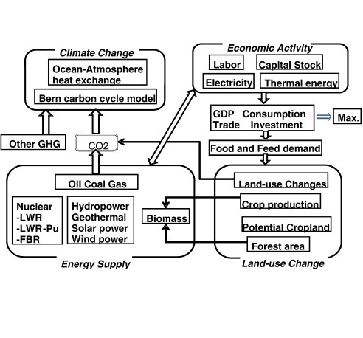
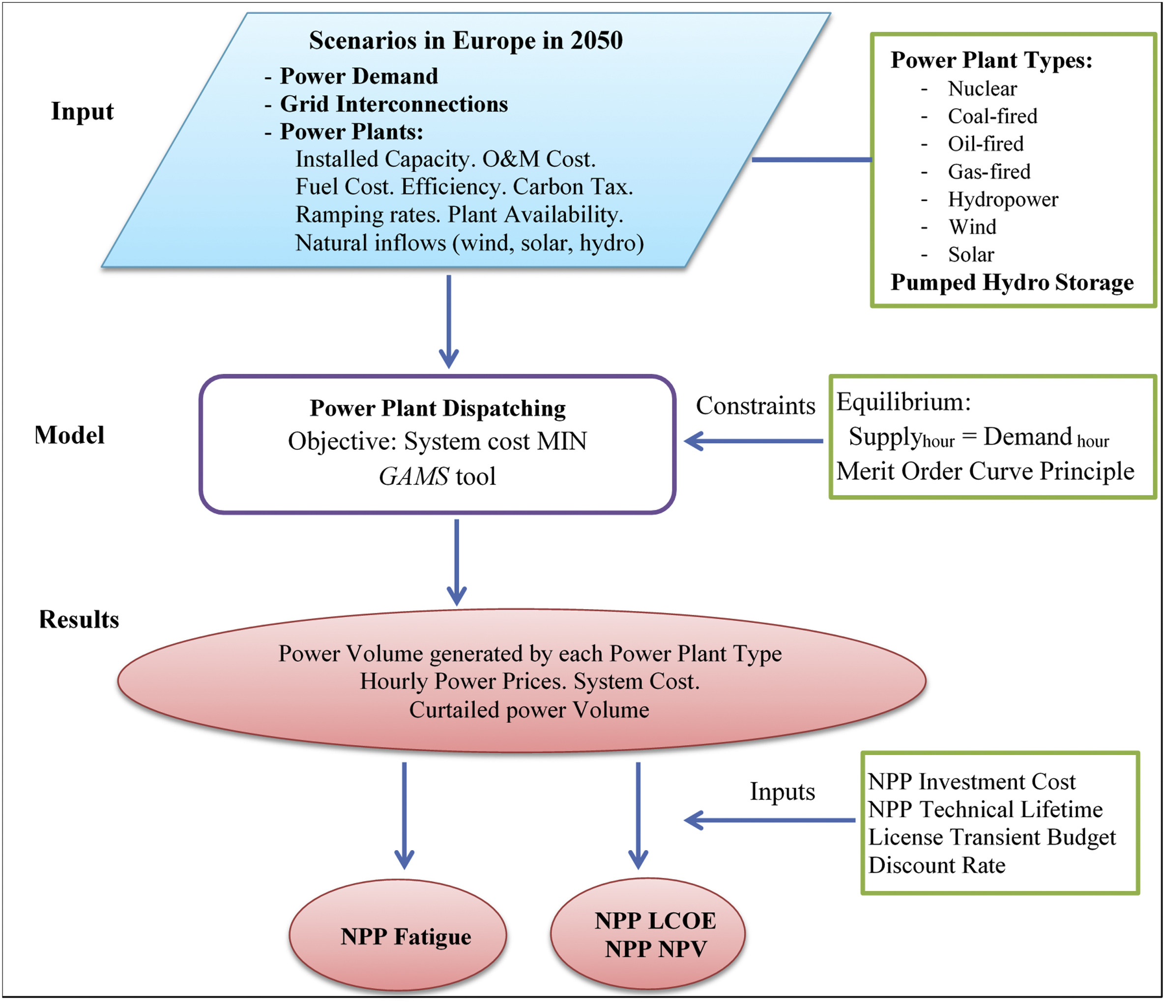
Energy System Dynamics
Energy models take yearly periods for energy balance
Energy usage depends on seasonal, daily and hourly human activities
Load-taking or load-shedding at system marginal price
Inter-regional energy import and export
Mitigation of trade-offs between economic growth and climate policies
Notes:
Loisel, R., Alexeeva, V., Zucker, A., & Shropshire, D. (2018). Load-following with nuclear power: Market effects and welfare implications. Progress in Nuclear Energy, 109, 280–292. https://doi.org/10.1016/j.pnucene.2018.08.011
Mori, S. (2012). An assessment of the potentials of nuclear power and carbon capture and storage in the long-term global warming mitigation options based on Asian Modeling Exercise scenarios. Energy Economics, 34(SUPPL. 3), S421–S428. https://doi.org/10.1016/j.eneco.2012.03.017

Slide 7
Simple Transport Model
Basic example derived from Dantzig (1963) example in GAMS Model Library
The objective is to minimize the total transport cost of cans from Seattle and San Diego to New York
The solution is trivial as the model will prefer transport from the shorter distance (Seattle) first as the transport cost is lower than the other route (San Diego)
Supply | Number of cans
Seattle | 300
San Diego | 400
Demand | Number of cans
New York | 600
Distance | 1000 miles
Seattle – New York | 2.5
San Diego – New York | 3.0
Transport cost | USD / 1000 miles
By freight | 90
Notes:
https://www.gams.com/mccarl/trnsport.gms

Slide 8
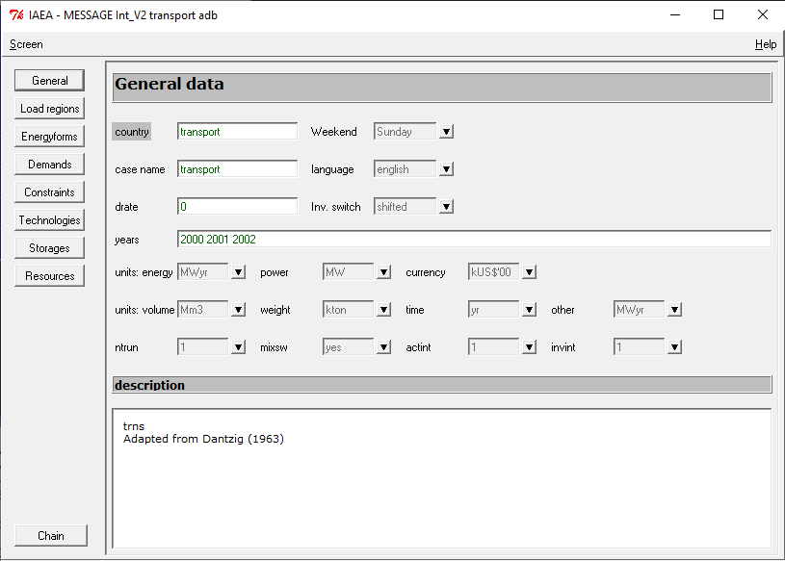
Building from Scratch
Start a new case from «Cases –> New -> create single region case»
Select the new case from «Cases -> Open»
Open the application database from «Edit -> application db»
Save the changes in the application database from «Screen -> Save and Close»
Save the changes to the case from «Cases -> Save»

Slide 9
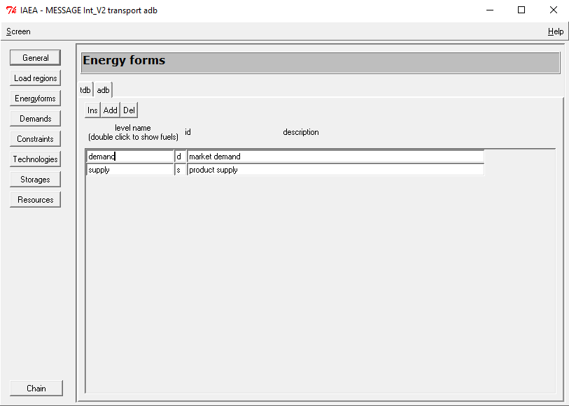
Energy Forms
Open the application database from «Edit -> application db»
Open the «Energy forms» tab
Enter the demand and supply levels with «Add» tab
Enter the supply and demand locations by double clicking to the demand and supply levels with «Add» tab
Save the changes in the application database from «Screen -> Save»

Slide 10
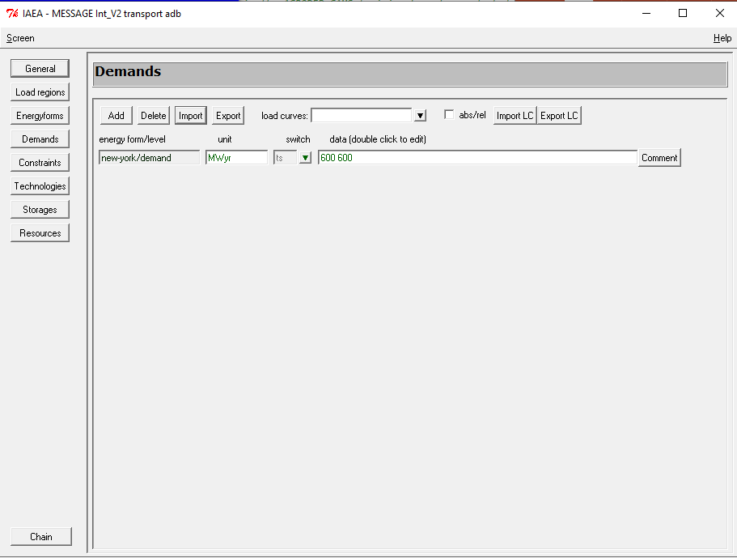
Demands
Open the «Demand» tab
Select the demand row from «Add» tab
Select the time switch as «c» as demand is constant during the modeling time horizon
Save the changes in the application database from «Screen -> Save»

Slide 11
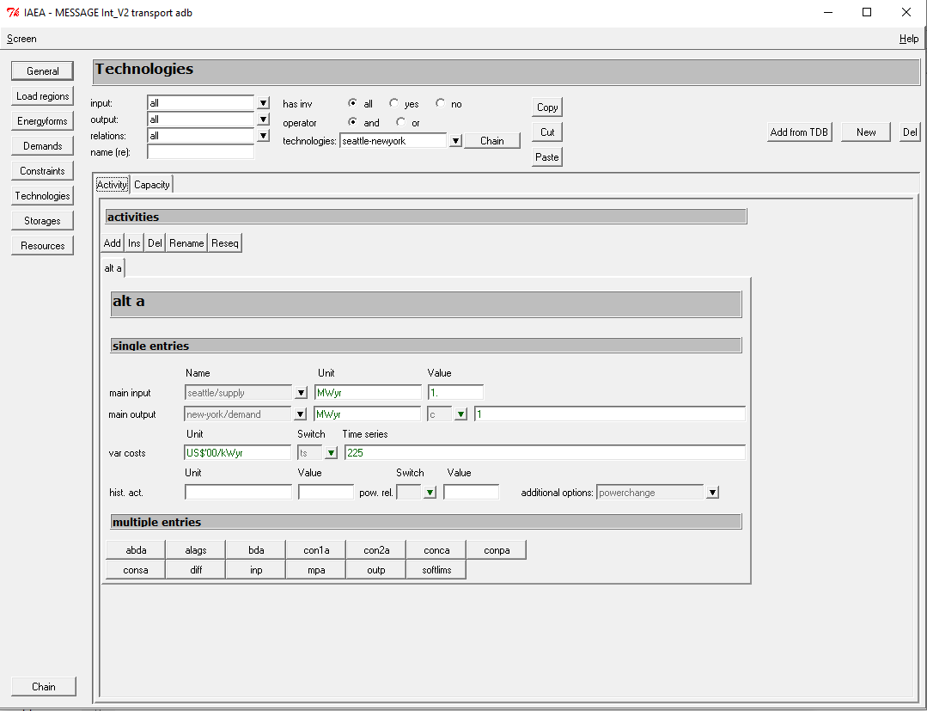
Technologies
Open the «Technologies» tab
Enter the transport technologies and costs from «Add» tab
The value of main inputs and main outputs should be clearly defined
Select the time switch as «c» as the transport costs are constant during the modeling time horizon
Save the changes in the application database from «Screen -> Save»

Slide 12
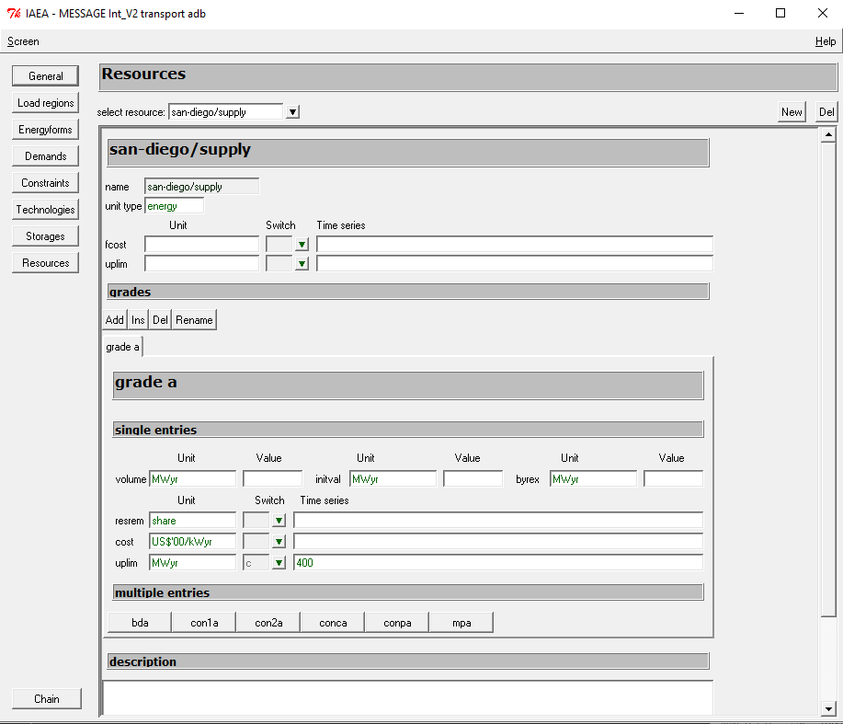
Resources
Open the «Resources» tab
Select the supply resources from «New» tab
Supplies are included as upper limits
Select the time switch as «c» as the upper production limits are constant during the modeling time horizon
Save the changes in the application database from «Screen -> Save and Close»
Save the changes to the case from «Cases -> Save»

Slide 13
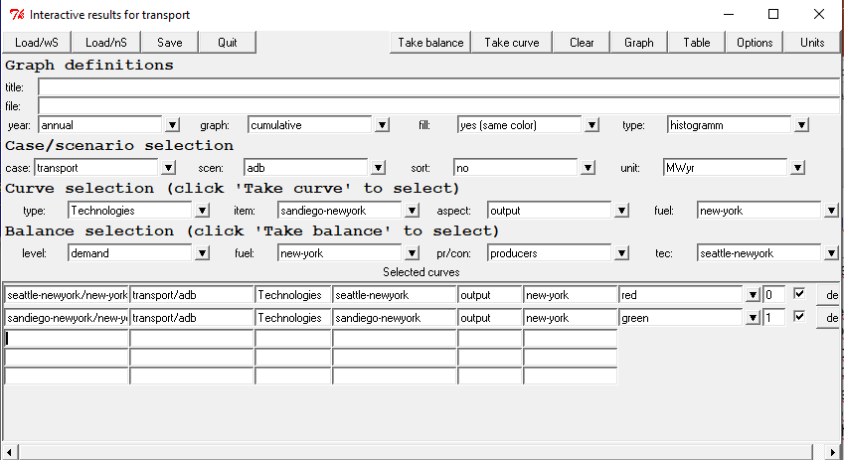
Running the Problem
Select the case from «Select -> scenario
Generate the lineer programming matrix from «Run -> mxg»
Run the optimization solver from «Run -> opt»
Select the «Results -> interactive» screen to see the results in tables and graphs
Rows | 30 | Equations
Cols | 4 | Variables
Elms | 22 | Parameters
Rhs | 11 | Right hand side constraints
Bnds | 2 | Constant bounds

Slide 14


Mathematical Solution
Primary solution
$$min.⟶z={\underline{c}}_{j}^{T}∗{\underline{x}}_{j}$$
$$s.t.⟶{\underline{\underline{A}}}_{ij}∗{\underline{x}}_{j}≥{\underline{b}}_{i}$$
$$x_{j}≥0 ∀j$$
Secondary solution
$$max.⟶w={\underline{b}}_{i}^{T}∗{\underline{u}}_{i}$$
$$s.t.⟶{\underline{u}}_{i}^{T}∗{\underline{\underline{A}}}_{ij}≤{\underline{c}}_{j}$$
$$u_{i}∈Q ∀i$$

Slide 15


Simple Transport Model
Primary solution
$$min.⟶z=225∗x_{seattle}+270∗x_{san−diego}$$
$$s.t.⟶x_{seattle}+x_{san−diego}≥600 (u1)$$
$$x_{seattle}≤300 (u2)$$
$$x_{san−diego}≤400 \left(u3\right)$$
$$x_{seattle}≥0 (u4)$$
$$x_{san−diego}≥0 (u5)$$
Secondary solution
$$max. ⟶w =600∗u1−300∗u2−400∗u3$$
$$s.t.⟶u_{1}−u_{2}+u_{4}≤225$$
$$u_{1}−u_{3}+u_{5}≤270$$

Slide 16
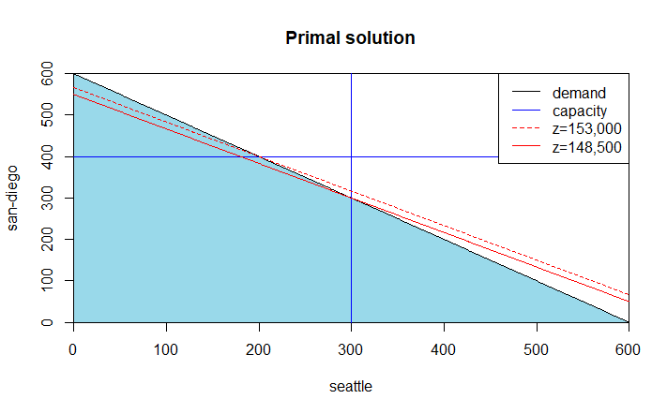
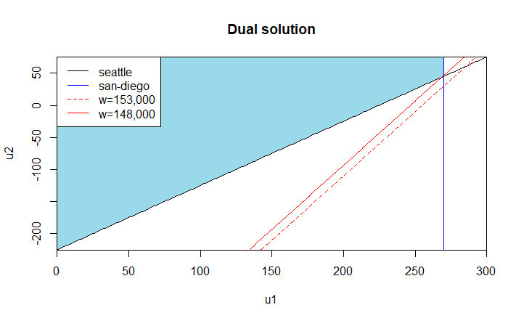
Simple Transport Model
Primal solution
Secondary solution (u3=u4=u5=0)

Slide 17
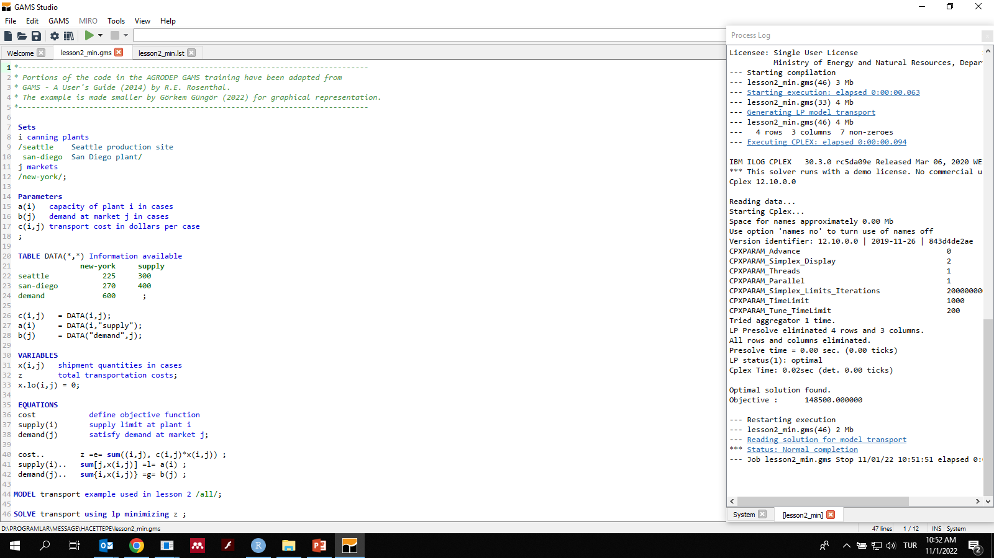
Model Intercomparison

Slide 18

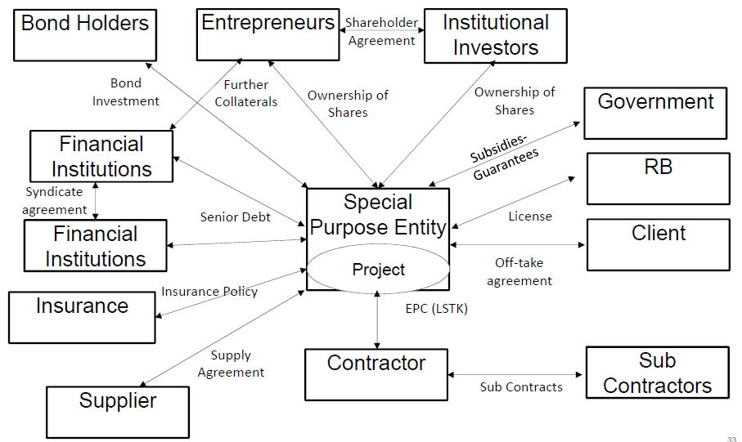
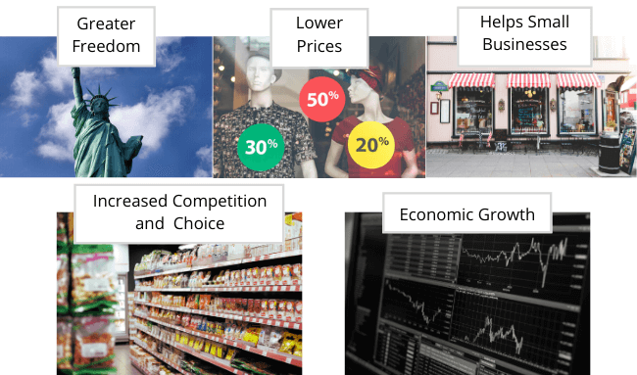
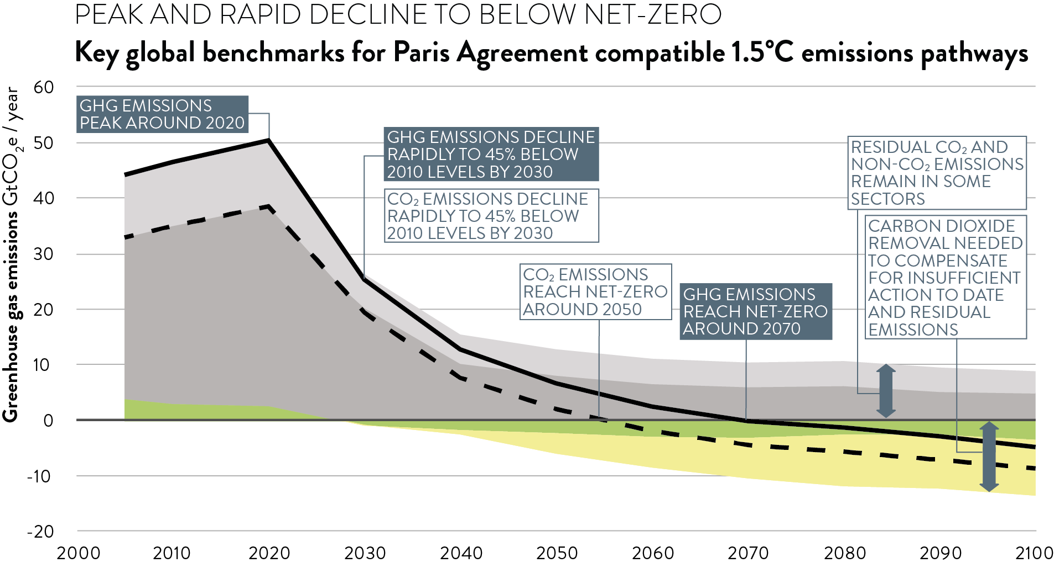

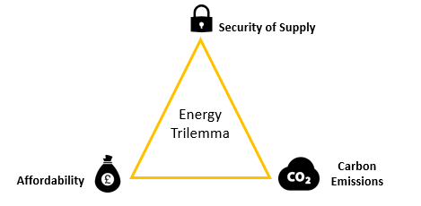
Energy System Modeling
Policy objectives:
Energy supply security
Climate change mitigation and adaptation
Market mechanisms
Investment financing
Sectoral subsidies (renewable energy, energy storage, e-fuels)
Foreign trade(EU Green Deal, China, USA)
Notes:
https://www.iaea.org/newscenter/news/iaea-continues-support-for-all-source-energy-planning-for-countries-despite-pandemic
http://www.esru.strath.ac.uk/EandE/Web_sites/17-18/windies/energy-trilemma.html
Dr Giorgio Locatelli PhD FHEA (2017). Organisational form supporting Climate Change Mitigation Strategies & plants. 1st Research Coordination Meeting on Assessments of the Potential Role of Nuclear Energy in National Climate Change Mitigation Strategies
https://climateanalytics.org/blog/2019/centred-on-science-how-the-ipcc-can-guide-mitigation-action/
https://boycewire.com/deregulation-definition-and-examples/
https://www.sciencedirect.com/science/article/abs/pii/S030142150400120X
https://ticaret.gov.tr/data/60f1200013b876eb28421b23/MUTABAKAT%20YE%C5%9E%C4%B0L.pdf

Slide 19
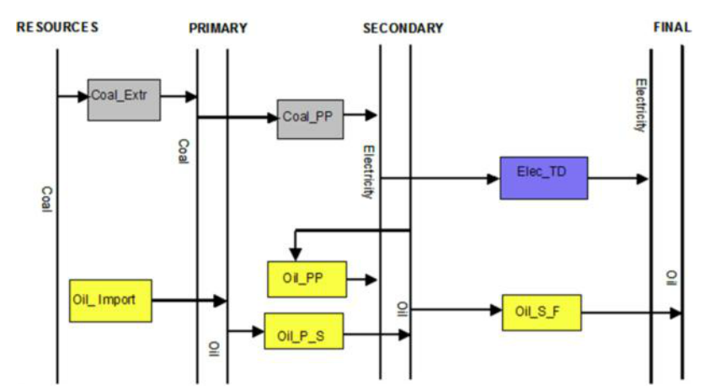
Simple Energy Supply System Model
Restore the simple energy supply model from «Cases –> Restore -> DEMO_CASE1»
Open the model from «Cases –> Open -> DEMO_CASE1»
Check the application database from «Edit -> application db» for the definiton of variables, technologies and parameters

Slide 20
Technology Parameters
Technology | Main input | Main output | Efficiency
Coal_Extr | Coal/Res. | Coal/Primary | 1
Coal_PP | Coal/Primary | Elec./Secon. | 0.36
Oil_Imp |  | Oil/Primary | 1
Oil_P_S | Oil/Primary | Oil/Secon. | 1
Oil_PP | Oil/Secon. | Elec./Secon. | 0.38
Ele_TD | Elec./Secon. | Elec./Final | 0.8
Oil_S_F | Oil/Secon. | Oil/Final | 1
Activity costs | USD / kWyr
Coal extraction | 48
Coal power plant | 25
Oil import | 110 in 2002 248 in 2005 and after
Oil power plant | 20
Investment costs | USD / kW
Coal power plant | 1000
Oil power plant | 600
Electricity T&D | 1000
Construction time | Years
Coal power plant | 4
Oil power plant | 3
Capacity addition | MW
Coal power plant | 200 in 1990 200 in 1995
Oil power plant | 100 in 1990 125 in 1995
Electricity T&D | 600 in 1995
Fixed costs | USD / kW/yr
Coal power plant | 30
Oil power plant | 10
Electricity T&D | 10

Slide 21
Energy Demand
Final electricity demand increases from 200 MWyr in 2002 by 5% each year
Final oil demand is constant at 50 MWyr
Oil is used as both final energy resource and input for secondary electricity generation
The country has 929338 MWyr coal resources whereas oil is supplied by import

Slide 22
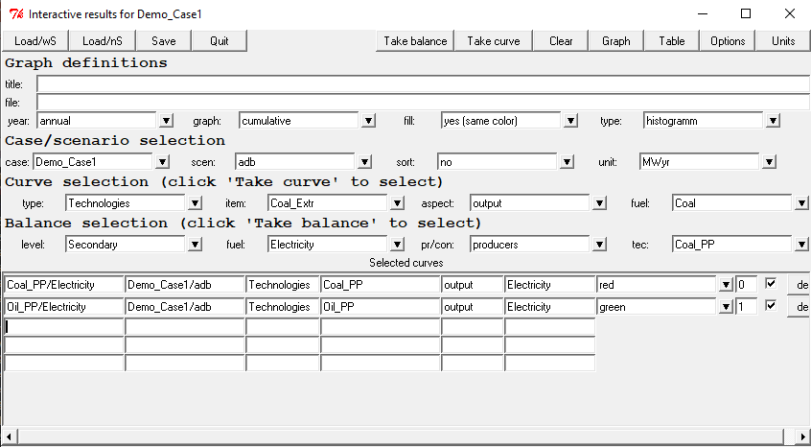
Running the Problem
Select the «adb» scenario from «Select -> scenario
Generate the lineer programming matrix from «Run -> mxg»
Run the optimization solver from «Run -> opt»
Select the «Results -> interactive» screen to see the results in tables and graphs
Rows | 134 | Equations
Cols | 71 | Variables
Elms | 574 | Parameters
Rhs | 47 | Right hand side constraints
Bnds | 5 | Constant bounds

Slide 23
Visualization of Results
Secondary Electricity
Total installed capacity

Slide 24
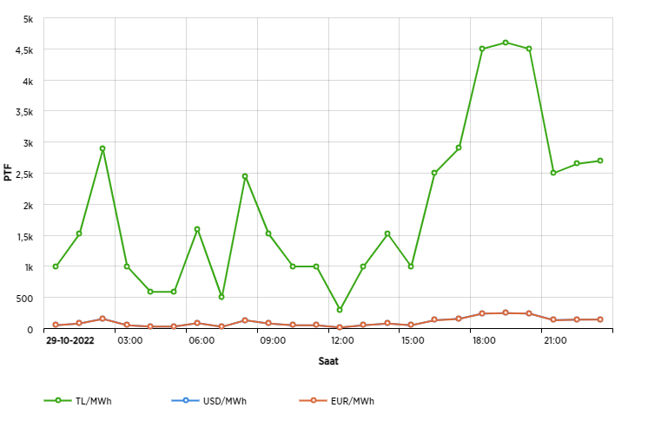
Electricity Demand
Electricity demand, without significant storage capability, changes significantly between seasons (summer or winter), days (workday or weekend) and hours (work or rest hour)
The electricity grid operator should balance the electricity supply and demand at all times
The day-ahead and intra-day markets generates the market exchange prices
Notes:
https://seffaflik.epias.com.tr/transparency/uretim/gerceklesen-uretim/gercek-zamanli-uretim.xhtml

Slide 25
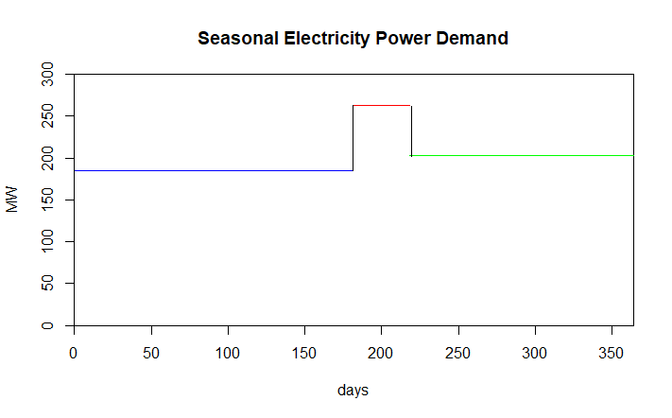
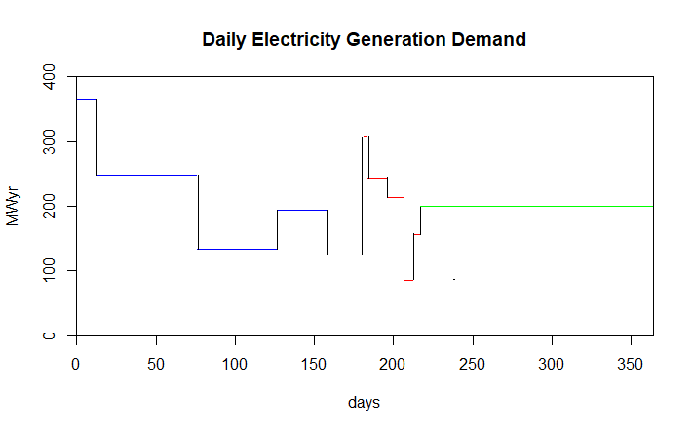
Electricity Demand

Slide 26
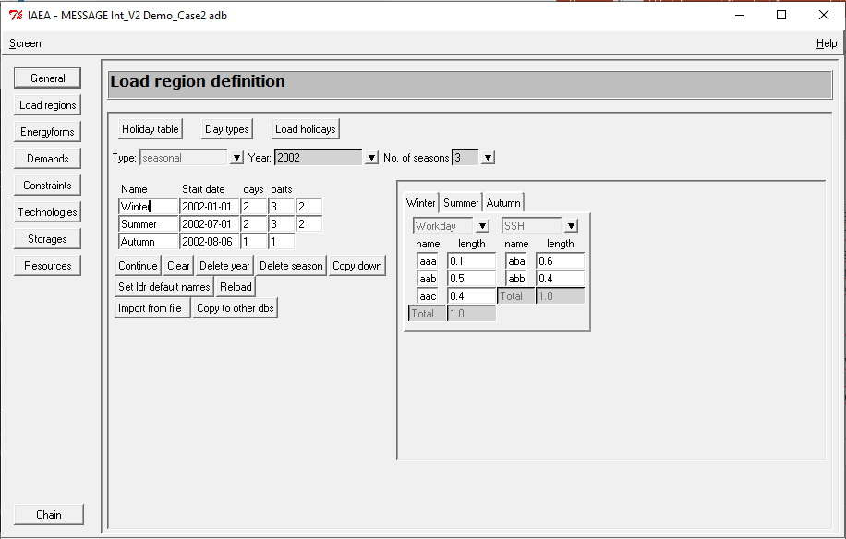
Load Regions
Restore the simple energy supply model with load regions from «Cases –> Restore -> DEMO_CASE2»
Open the model from «Cases –> Open -> DEMO_CASE2»
Check the application database from «Edit -> application db» for the definiton of variables, technologies and parameters
The seasons are winter, summer and autumn with workdays seperated to three and holidays seperated to two parts
Notes:
https://www.gams.com/mccarl/trnsport.gms

Slide 27
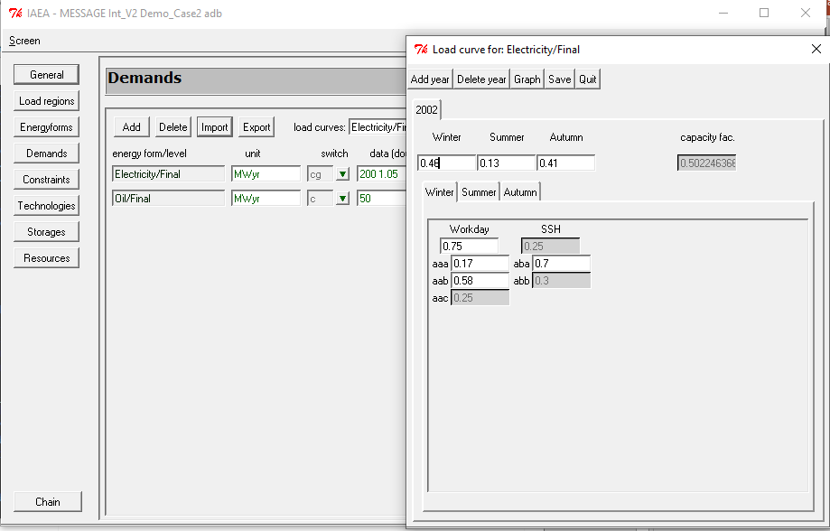
Demand Load
Select the load curve for final electricity from «Demand»
Final electricity demand load changes both seasonally and hourly with a yearly load factor of 0.5
We expect the optimization solver to select the:
Low capital and high operation cost technology for peak load electricity
High capital and low operation cost technology for base load electricity
Rows | 334 | Equations
Cols | 191 | Variables
Elms | 2254 | Parameters
Rhs | 147 | Right hand side constraints
Bnds | 5 | Constant bounds

Slide 28
Visualization of Results
Secondary Electricity
Total installed capacity

Slide 29
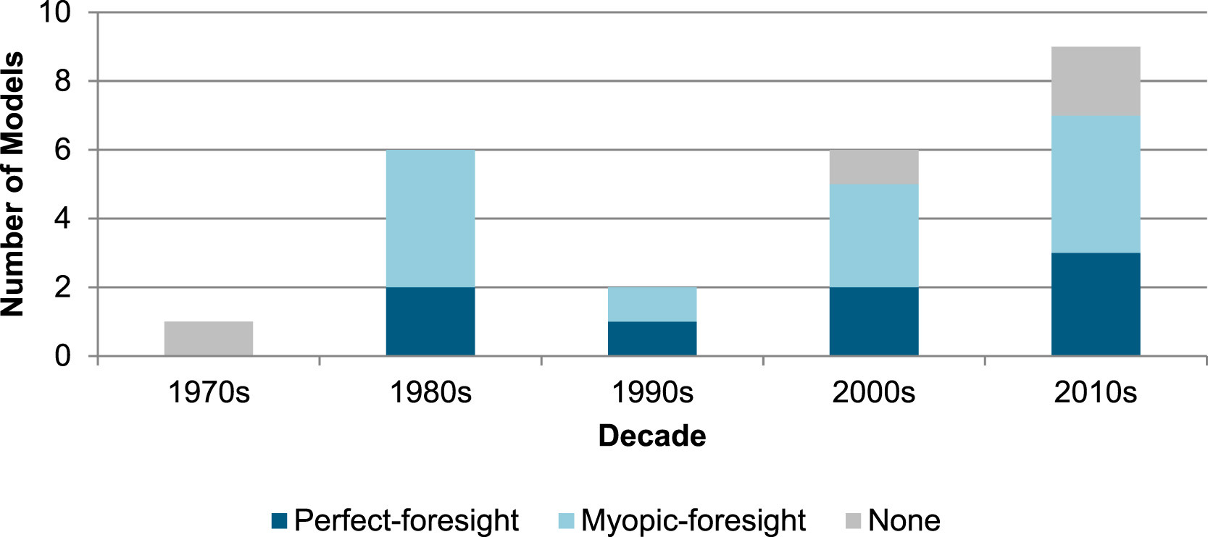
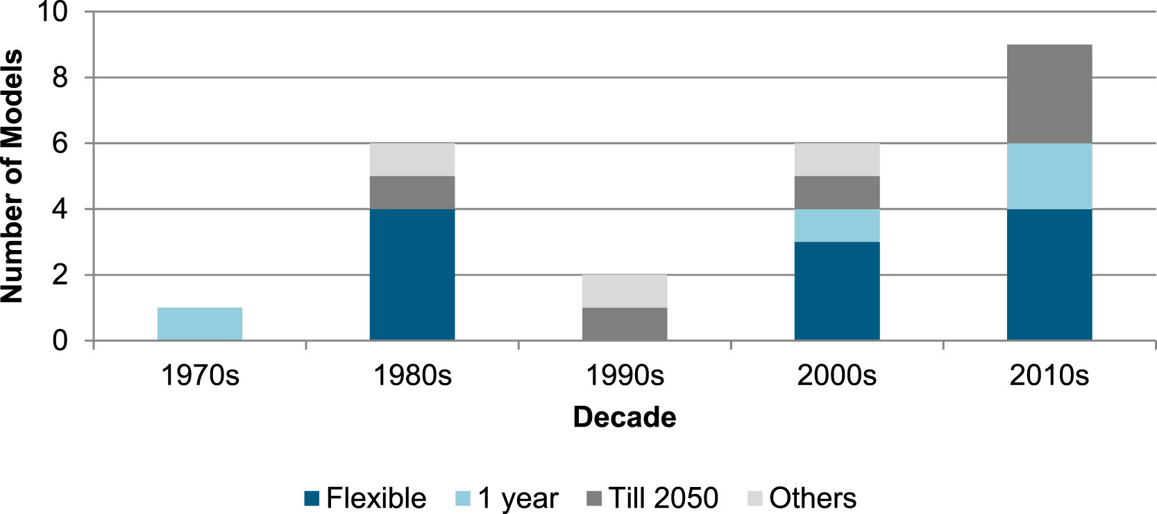
Time Horizon
The time horizons of energy system models can be fixed or flexible
2050 is one of the most important targets of the Paris Agreement
MESSAGE implements a perfect-foresight approach with decisions made considering the complete time horizon
Economic decisions are more short-sighted which can be modeled using a myopic-foresight approach
Notes:
Lopion, P., Markewitz, P., Robinius, M., & Stolten, D. (2018). A review of current challenges and trends in energy systems modeling. Renewable and Sustainable Energy Reviews, 96, 156–166. https://doi.org/10.1016/j.rser.2018.07.045

Slide 30
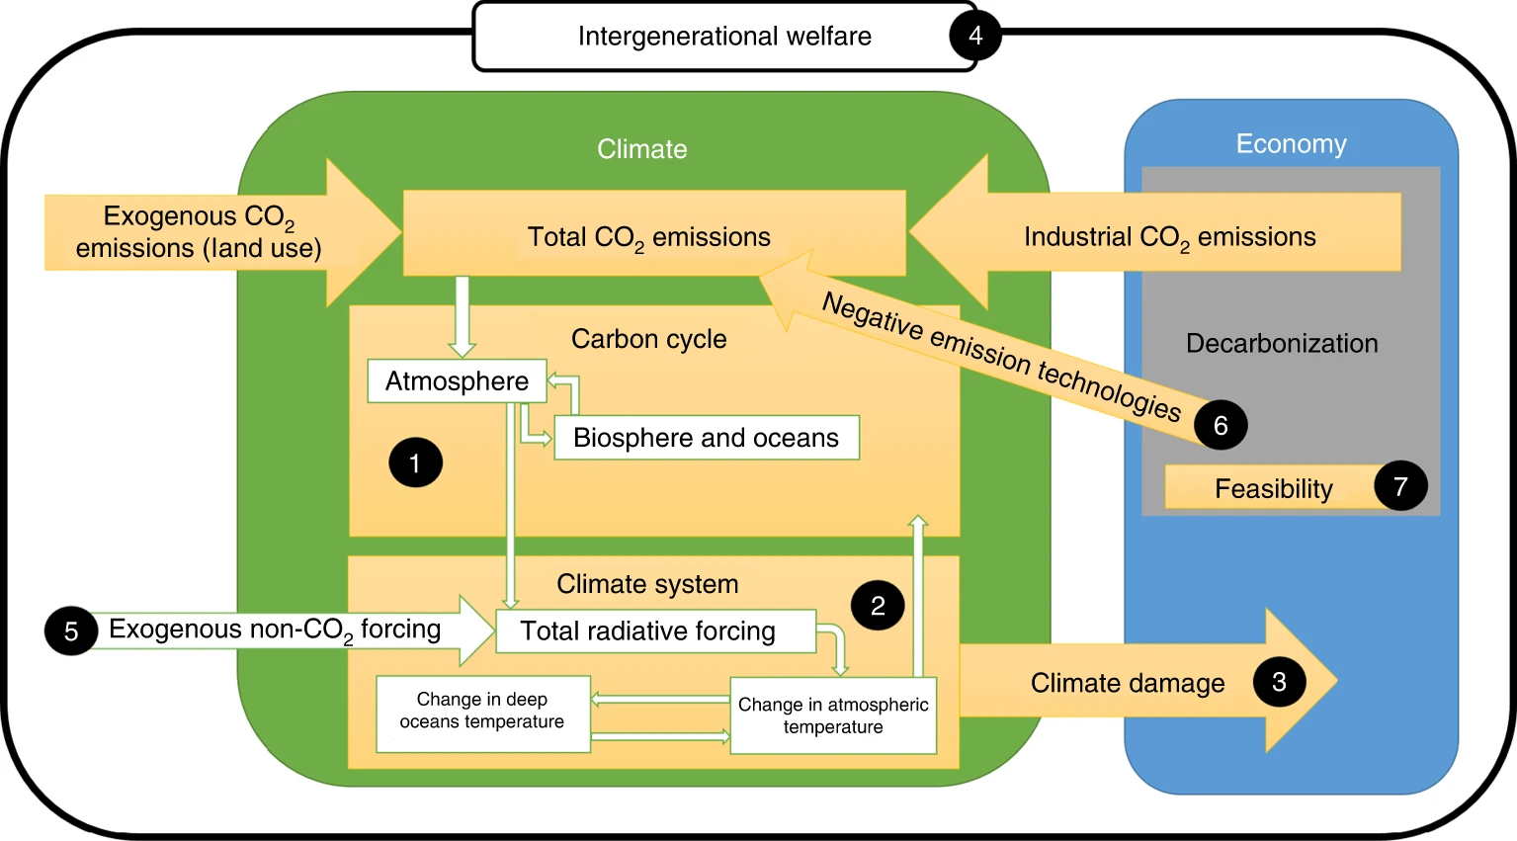
Discount Rate
Why should I take the burden of spending today when the productivity is low and the costs are high?
Why should the future generations take the burden of our costs when they can be better off without them?
Ethical conflicts arise in long-term problems, such as climate change, biodiversity loss and nuclear waste disposal
Climate models are very sensitive to discount rates and climate feedbacks
Notes:
Carson, R. T., & Tran, B. R. (2009). Discounting Behavior and Environmental Decisions. Journal of Neuroscience, Psychology, and Economics, 2(2), 112–130. https://doi.org/10.1037/a0017685
Hänsel, M. C., Drupp, M. A., Johansson, D. J. A. A., Nesje, F., Azar, C., Freeman, M. C., Groom, B., & Sterner, T. (2020). Climate economics support for the UN climate targets. Nature Climate Change, 10(8), 781–789. https://doi.org/10.1038/s41558-020-0833-x

Slide 31
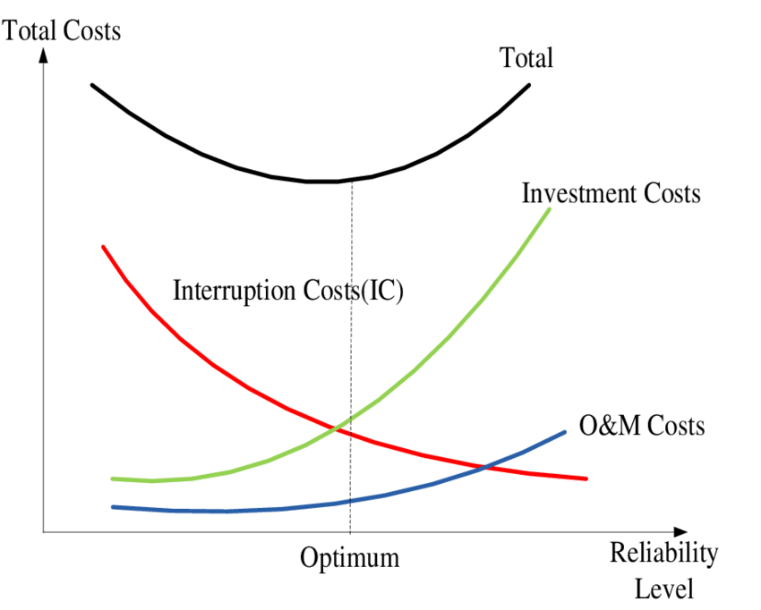
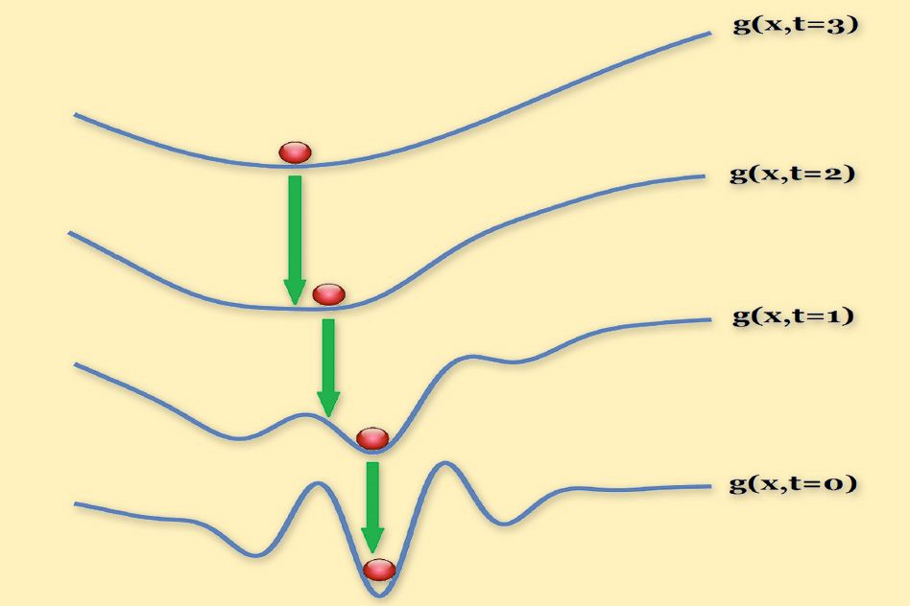
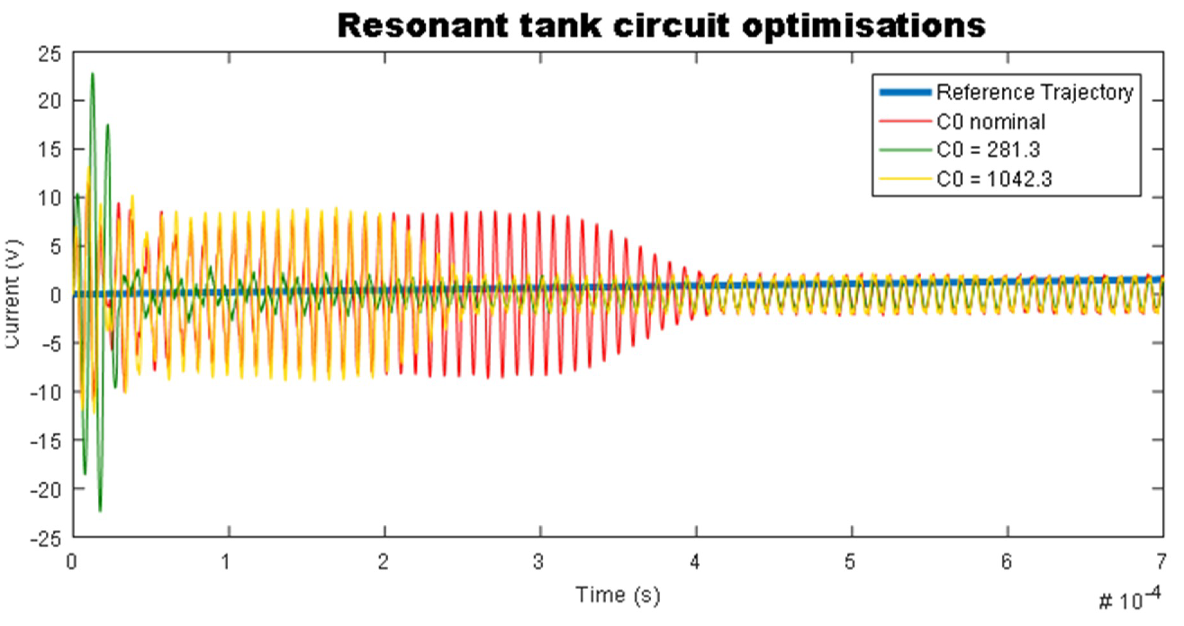
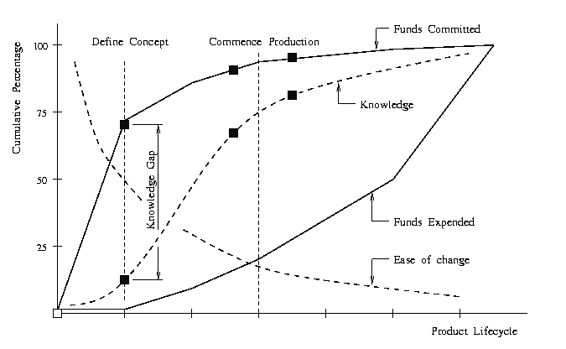
Quiz #2 (Take-home)
Optimization can achieve the pareto optimal solution and inter-generational equity for resource usage.
Can you briefly explain an optimization problem in your academic field?
Open with the take home message (most important thing to share)
Q1: Why are we here?
Q2: Says who (if you use outside sources, please cite them) ?
Q3: So what?
Notes:
https://news.mit.edu/2015/optimizing-optimization-algorithms-0121
https://www.researchgate.net/figure/Socio-economic-optimization-of-network-security_fig1_306355031
https://www.mdpi.com/2079-9292/8/7/799/htm
https://user.eng.umd.edu/~austin/ence202.d/optimization.html

Slide 32
References
[1] Klaassen G, Riahi K. Internalizing externalities of electricity generation: An analysis with MESSAGE-MACRO. Energy Policy [Internet]. 2007. 35(2):815–27.
[2] Loisel R, Alexeeva V, Zucker A, Shropshire D. Load-following with nuclear power: Market effects and welfare implications. Prog Nucl Energy [Internet]. 2018. 109:280–92.
[3] Mori S. An assessment of the potentials of nuclear power and carbon capture and storage in the long-term global warming mitigation options based on Asian Modeling Exercise scenarios. Energy Econ [Internet]. 2012. 34(SUPPL. 3):S421–8.
[4] Lopion P, Markewitz P, Robinius M, Stolten D. A review of current challenges and trends in energy systems modeling. Renew Sustain Energy Rev [Internet]. 2018. 96:156–66.
[5] Carson RT, Tran BR. Discounting Behavior and Environmental Decisions. J Neurosci Psychol Econ. 2009. 2(2):112–30.
[6] Hänsel MC, Drupp MA, Johansson DJAA, Nesje F, Azar C, Freeman MC, et al. Climate economics support for the UN climate targets. Nat Clim Chang [Internet]. 2020. 10(8):781–9.

